Slide 1

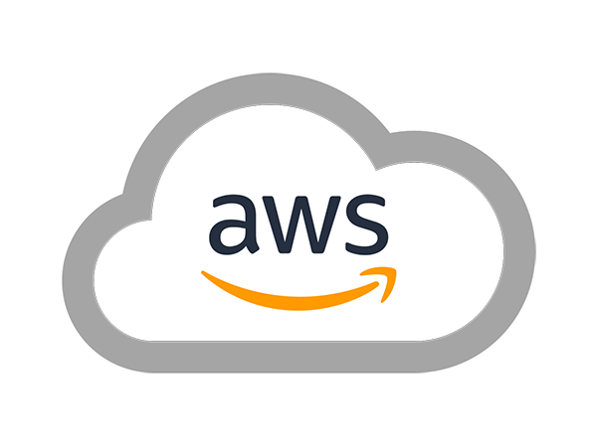
AWS SOLUTIONS ARCHITECT ASSOCIATE
Module 14:
Architecture Best Practices

Slide 2
Module Overview
Design for Failure and Nothing Fails
Implement Elasticity
Leverage Different Storage Options
Build Security in Every Layer

Slide 3

Lesson 01: Design for Failure and Nothing Fails

Slide 4
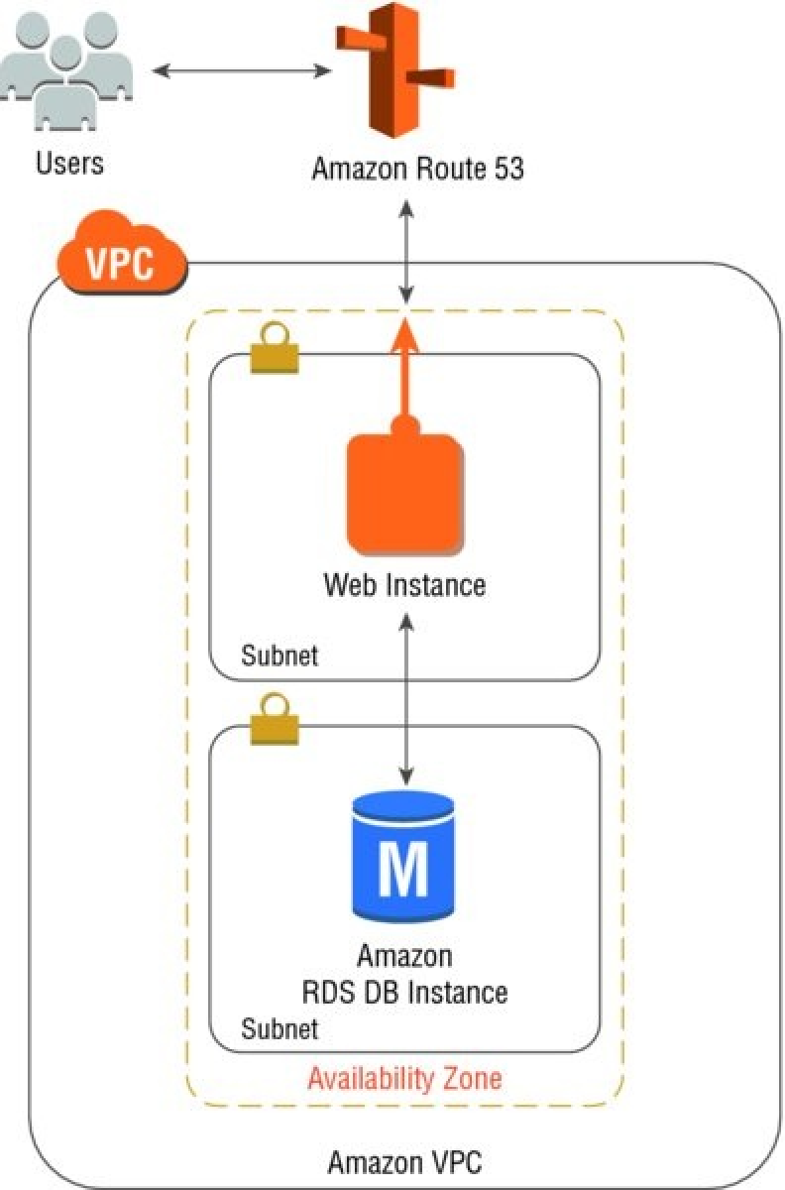
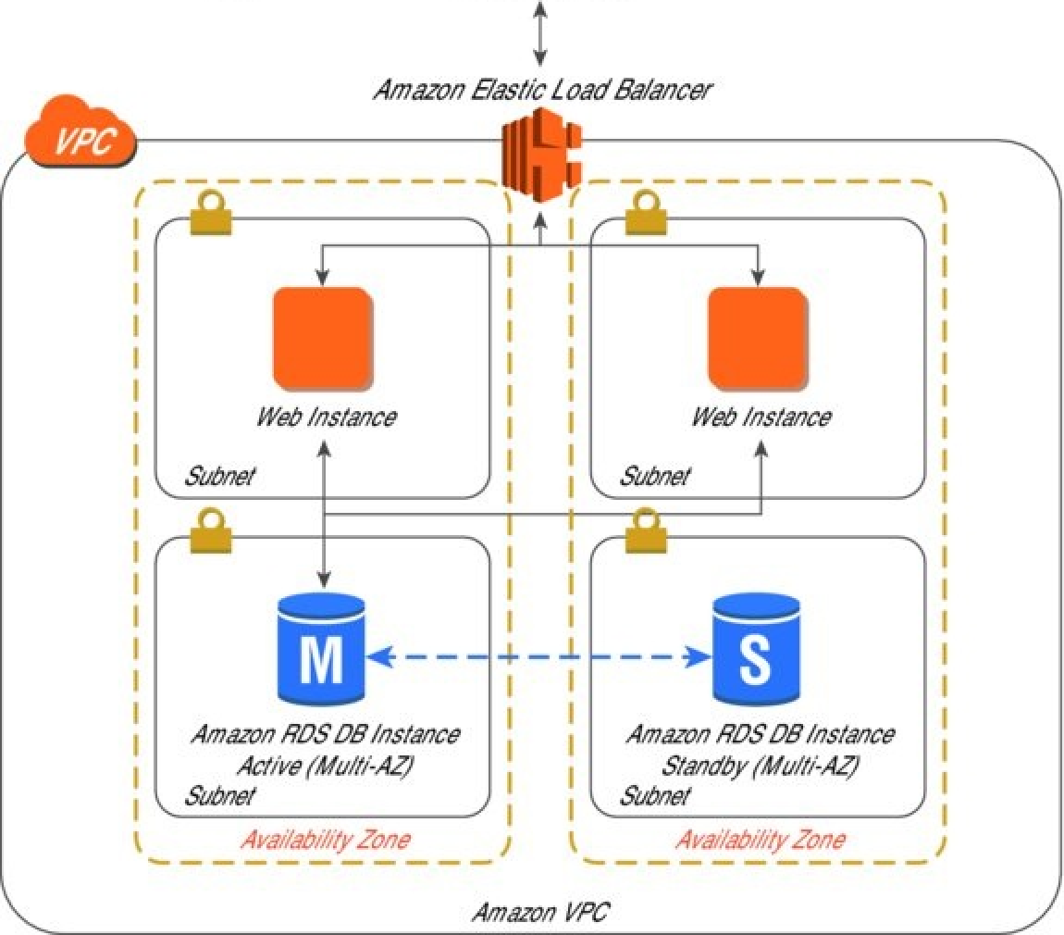
Design for Failure and Nothing Fails
Simple Web Application Architecture
Redundance Web Application Architecture

Slide 5
Lesson 02: Implement Elasticity

Slide 6
Implement Elasticity
Scaling Vertically
Scaling Horizontally
Stateless Applications
Stateless Components
Stateful Components
Deployment Automation
  Automate Your Infrastructure
  Bootstrap Your Instances

Slide 7
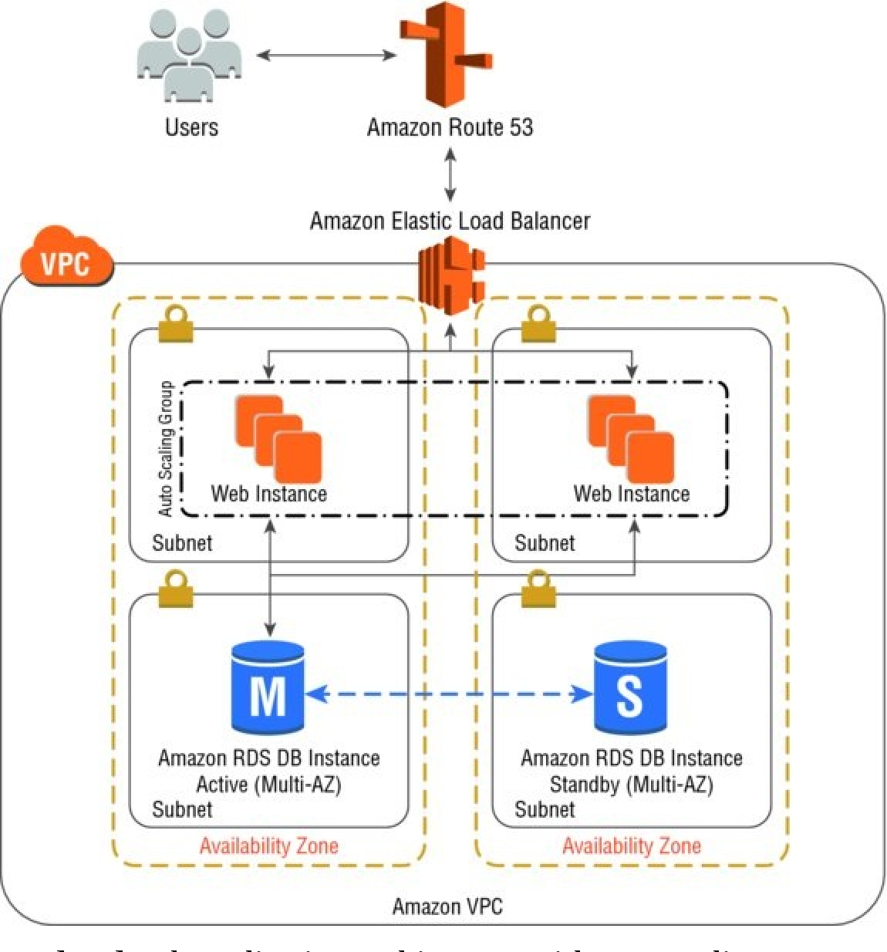
Implement Elasticity
Web Application Architecture with Auto Scaling

Slide 8
Lesson 03: Leverage Different Storage Options

Slide 9
Leverage Different Storage Options
Sample Scenario | Storage Option
Your web application needs large-scale storage capacity and performance. You need cloud storage with high data durability to support backup and active archives for disaster recovery. | Amazon S3
You require cloud storage for data archiving and long-term backup. | Amazon Glacier
You require a content delivery network to deliver entire websites, including dynamic, static, streaming, and interactive content using a global network of edge locations. | Amazon CloudFront
You require a fast and flexible NoSQL database with a flexible data model and reliable performance. | Amazon DynamoDB
You need reliable block storage to run mission-critical applications such as Oracle, SAP, Microsoft Exchange, and Microsoft SharePoint. | Amazon EBS

Slide 10
Leverage Different Storage Options
Sample Scenario | Storage Option
You need a highly available, scalable, and secure MySQL database without the time-consuming administrative tasks. | Amazon RDS
You need a fast, powerful, fully-managed, petabyte-scale data warehouse to support business analytics of your e-commerce application. | Amazon Glacier
You require a content delivery network to deliver entire websites, including dynamic, static, streaming, and interactive content using a global network of edge locations. | Amazon Redshift
You need a Redis cluster to store session information for your web application. | Amazon ElastiCache
You need a common file system for your application that is shared between more than one Amazon EC2 instance. | Amazon Elastic File System (Amazon EFS)

Slide 11
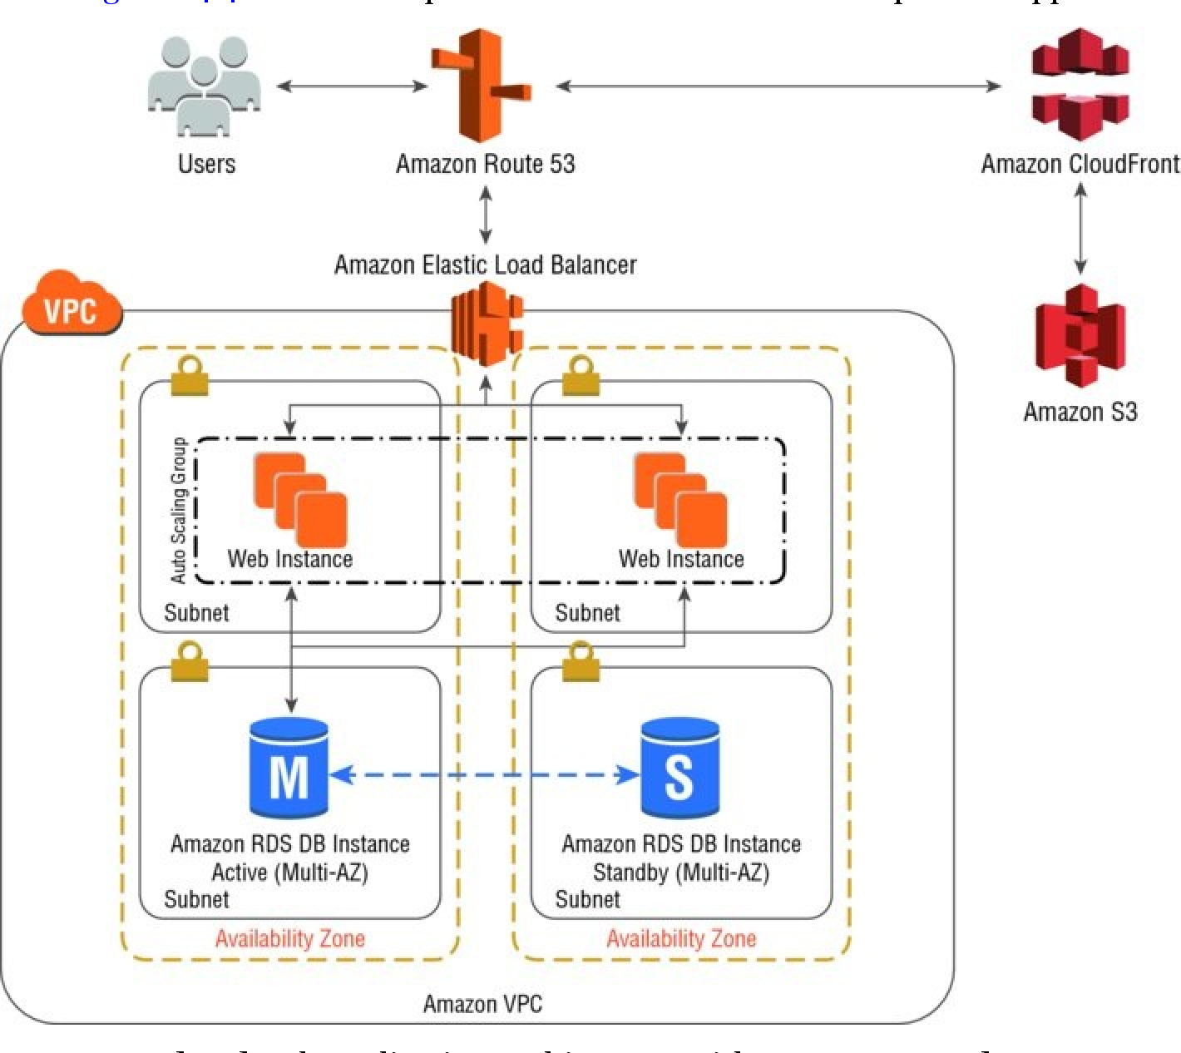
Leverage Different Storage Options
Web Application Architecture with Amazon S3 & Amazon CloudFront

Slide 12
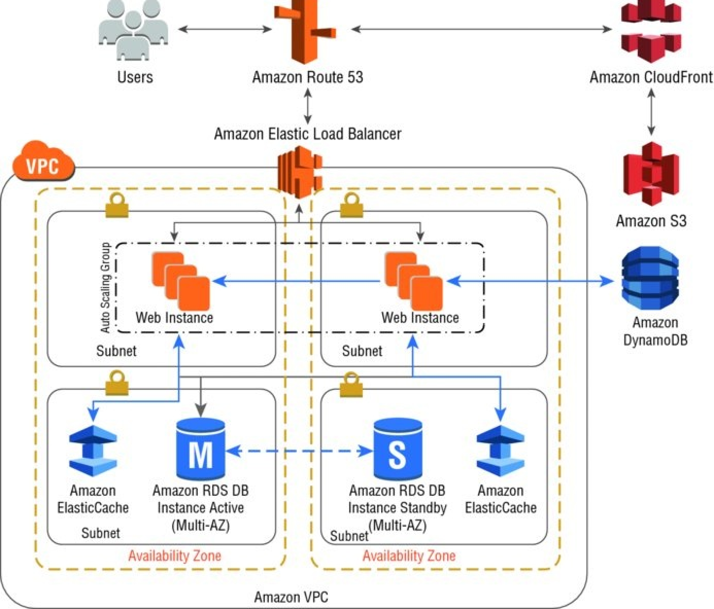
Leverage Different Storage Options
Web Application Architecture with Amazon ElastiCache and Amazon
DynamoDB

Slide 13
Lesson 04: Build Security in Every Layer

Slide 14
Build Security in Every Layer
Use AWS Features for Defense in Depth
Offload Security Responsibility to AWS
Reduce Privileged Access
Security as Code
Real-Time Auditing

